Slide 1

Olympic Data from 1896 to 2016

Slide 2

OLYMPICS 1986 – 2016
DATA SET:
Our sample population consists of 271,116 records containing data relating to the Olympics from the years 1896 to 2016. The dataset includes Athlete Name, Sex, Age, Height, Weight, Team, NOC (National Olympic Committee designated 3-digit country code), Games, Year, Season (Winter, Summer), City (host city), Sport, Event, and Medal won.
DATA EVALUTION:
After performing a count of the data, we identified that out of the 271,116 events, 39,783 medals were awarded. We used medals awarded, along with age, sex and participating country as the basis for developing the plots included.

Slide 3
OLYMPICS 1986 – 2016
DATA CLEAN UP:
In evaluating the number of medals awards, we sliced the data set to include only those records where a medal was won.
We changed the NOC (National Olympic Committee) code name to “Country”
We dropped any NaN’s that were included in dataset that did not pertain to respective plot.
We verified the data types, shape, value counts, and medal counts to assess that the correct data is being used for the plots.
We sorted data by year, age, season, medal count, country and gender to plot data.

Slide 4
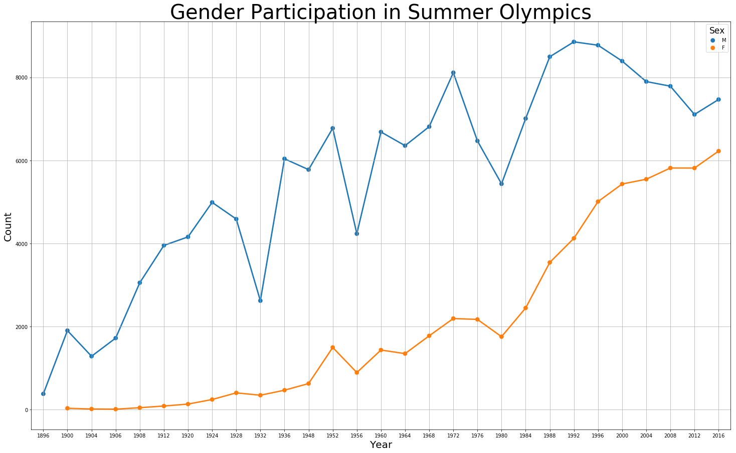
What was the number of male and female participants by year during the Summer Olympics from 1896 - 2016 and why did they differ? Historically there have been more male athletes than female, however by 2016 the gap has narrowed substantially. In analyzing male participation, the following Olympic games have notable decreases, 1932, 1956 and 1980. The 1932 games were affected by the Great Depression. 1956 had boycotts because the Soviet Union invaded Budapest and protests by Egypt, Lebanon and Iraq due of the Israeli invasion of the Sinai Peninsula. 1980 had the US boycott of the games being held in Russia, 65 other countries also boycotted these games, which created the largest boycott in Olympic history.

Slide 5
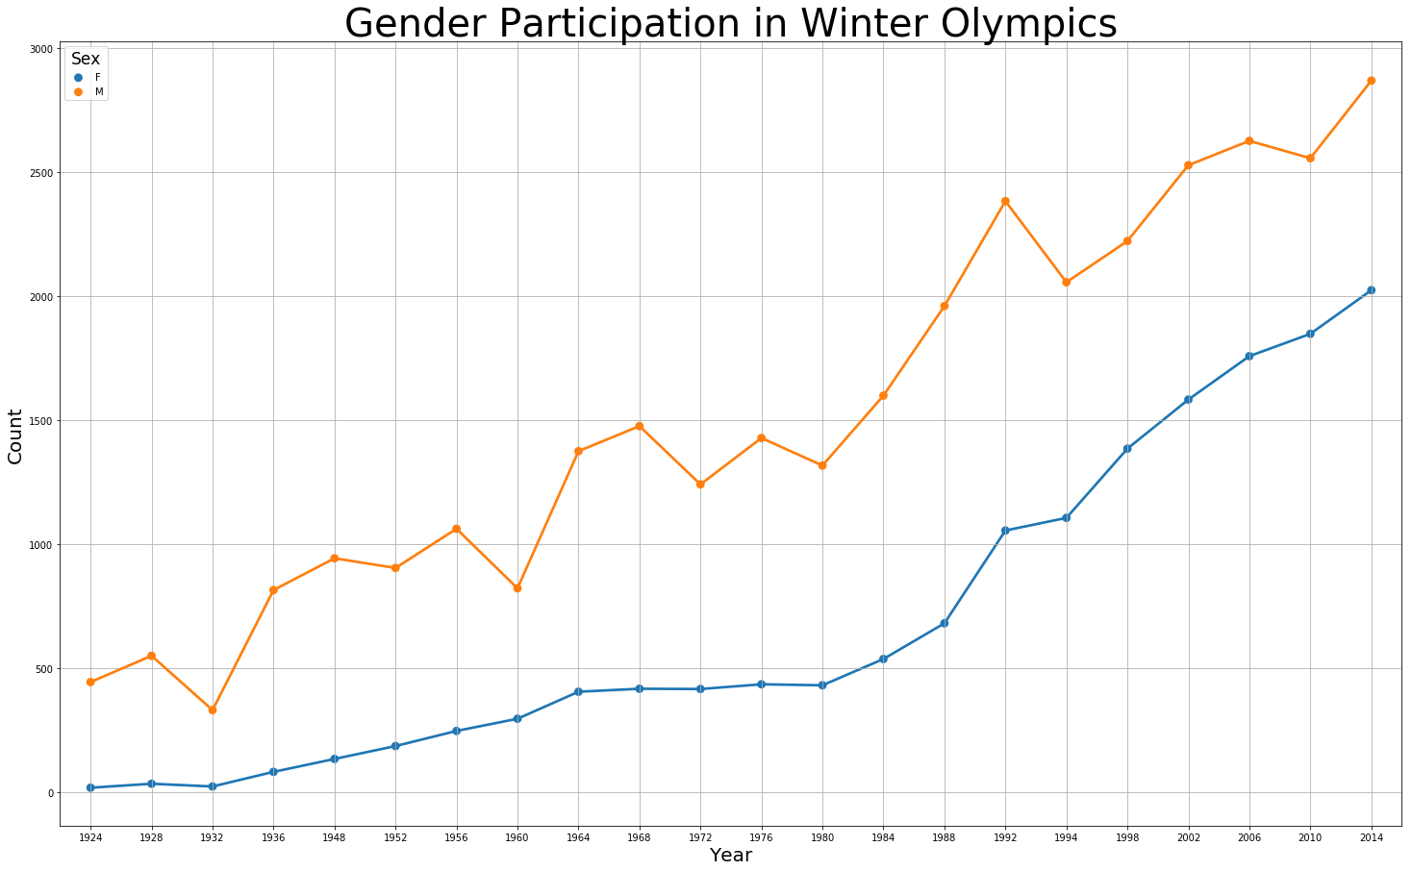
What was the total number of male and female participants during the Winter Olympics across all Olympic games and how did they differ? Historically, there have been more male athletes during the Winter Olympics as well, however the disparity between male and female participants is less in the winter due to the volume of Winter Events compared to Summer Events. In addition, world events affecting the Olympics were more prevalent closer to the Summer Games.

Slide 6
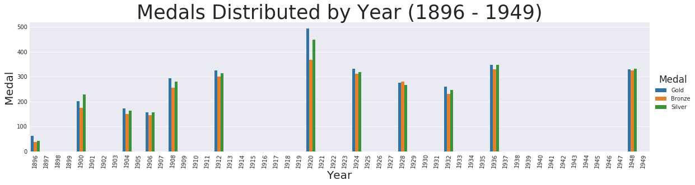
How many medals were distributed during each Olympic games? How did the splitting of winter games to their own years affect these results? Did World events have an impact? Our data shows games were affected by world events, specifically, both World Wars, which cancelled the 1916, 1940 and 1944 games.

Slide 7
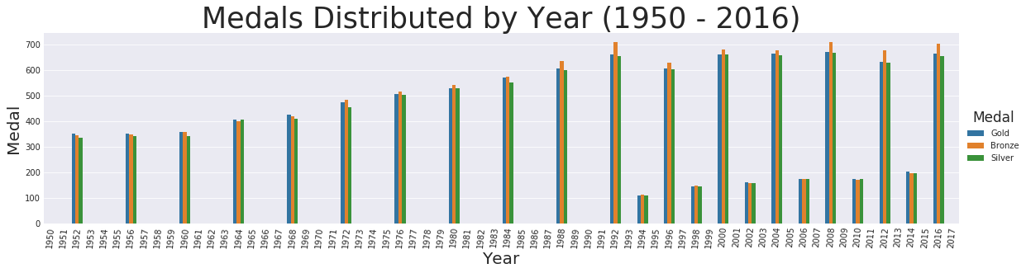
We also observed the Winter Games were split from taking place in the same year as the Summer games starting in 1994. Since then, each season has been staggered every 4 years.

Slide 8
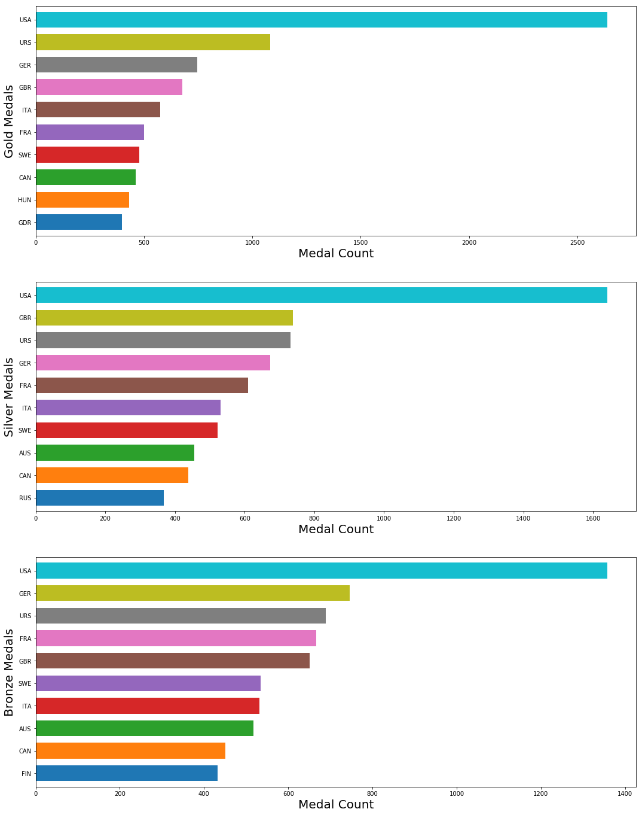
Which country has the most medal count in Gold, Silver and Bronze? We wanted to observe which country had collected the most medals in Olympic history and the data shows USA, USA, USA!

Slide 9
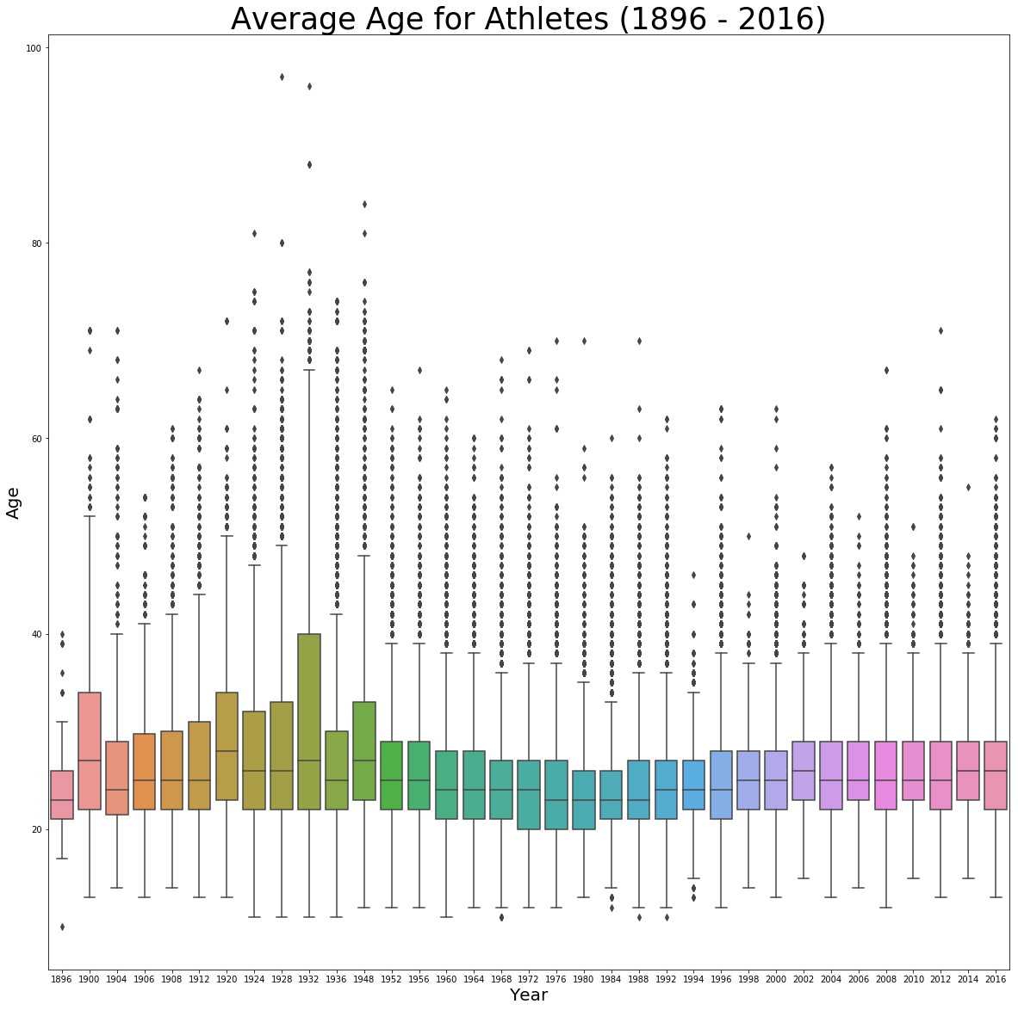
What is the average age of all athletes? We wanted to see the average age of athletes including oldest and youngest and how they differed for each game. We noticed that the average age seems to have hovered around 24 for the past 15 years. Oldest - John Quincy Ward...oldest Olympic participant (97) Amsterdam Summer 1928 - Art Competitions Youngest - Ethnikos Syllogos (10) – Athens Summer 1896 – Men’s Parallel Bars

Slide 10
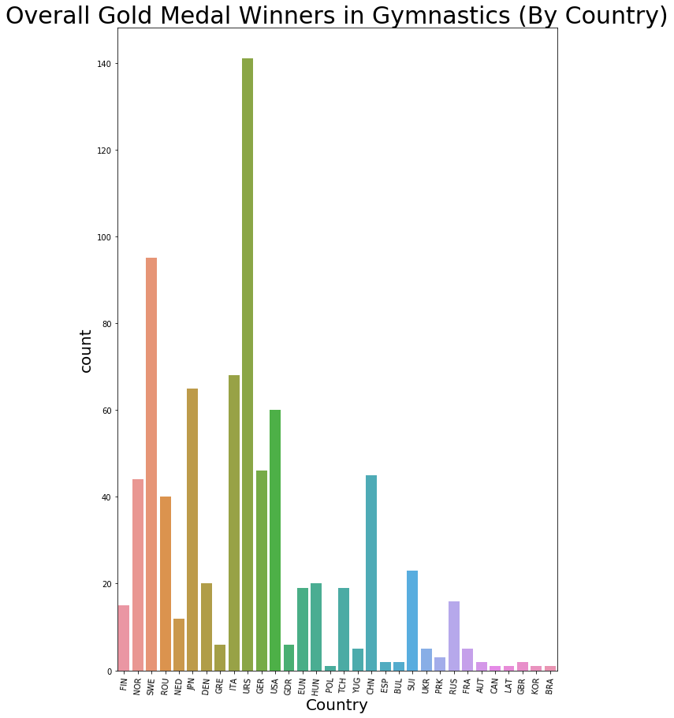
Which Country has the most Gold Medals in an individual Summer Sport? We were curious to see which country had won the most gold medals in a random summer event. We chose Gymnastics and found that Russia has historically dominated the gold medal count in gymnastics. After the break up of the USSR, the medals won by other countries within the empire were inherited by Russia.

Slide 11
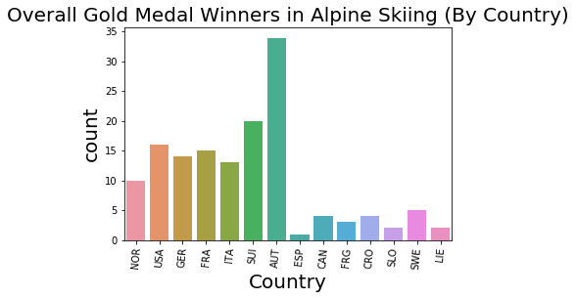
Which Country has the most Gold Medals in an individual Winter Sport? We were curious to see which country had won the most gold medals in a random winter event. We chose Alpine Skiing and found that Austria has the most gold medals. Geographically, Austria is located in the heart of the Alps, so everyone skis!!

Slide 12
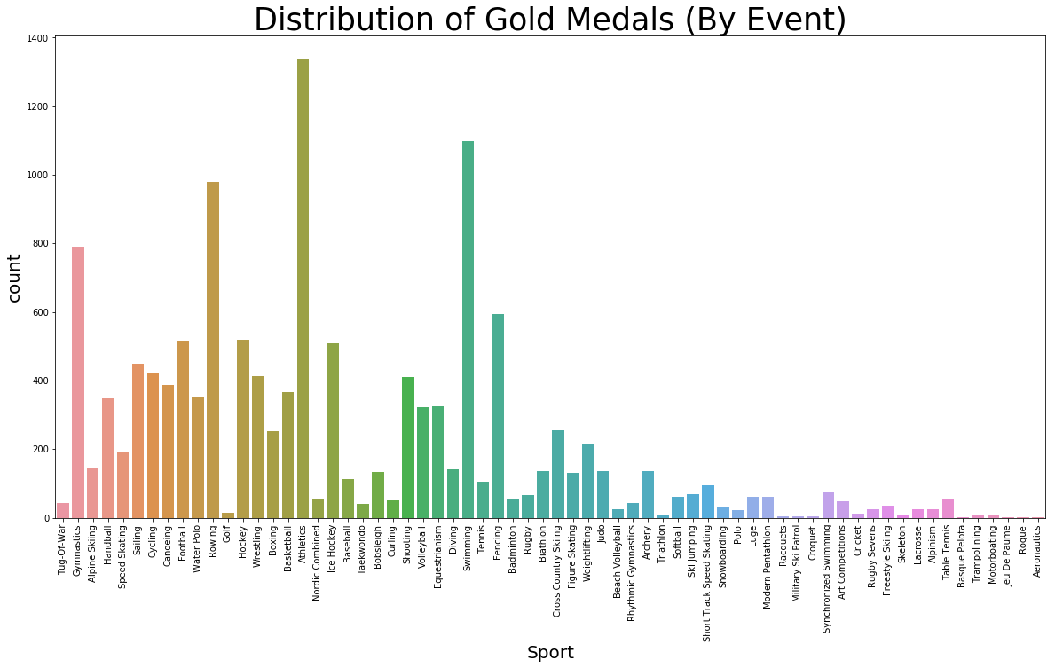
Which sport has given out the most gold medals over time? Track and Field has more events and can offer more gold medals. Swimming also has many events and therefore more gold medals. However, we found obscure events like Roque, Aeronautics, Basque Pelota.

Slide 13
Conclusion:
The decline of male participation in the summer games has a direct correlation to world events such as the Great Depression, political boycotts and invasions of other countries.
The gaps in the medals awarded every 4 years from 1896 to 1949 indicated that games were not held in the respective years where no medals were awarded due to world wars.
The summer and winter games were held in the same year up to 1994. After 1994 the summer and winter games were staggered every 4 years.
The United States leads in the total number of Gold, Silver and Bronze Medals awarded. The hypothesis can be made that economic might and love of sports has developed some of the best athletes in the world. The diversity of the population in the US has also brought a plethora of talents in different sporting events.
The average age of Olympic participants is 24.
Russia dominates the world in number of gold gymnastic medals won due to the aggregation of Russian states that were once under USSR.
Austria leads the world in the number of gold medals won in skiing. Austria’s geographic location makes it a common sport in a country surrounded by alps.
The 120 year 0lympic data history has evolved throughout the years with respect to the number of sporting events and types of events that have been awarded the most medals. There is a direct correlation between the quantity of events in any one sport and the number of medals awarded such as athletics which includes a variety of track and fields events.

